Slide 1
HELMET
DETECTION

Slide 2
AGENDA
We are team 72 we are working on the project Helmet detection. The Helmet Detector project aims to enhance safety measures in various real-world applications by accurately detecting the presence of helmets in images or video footage. By utilizing advanced deep learning algorithms provided by AWS Recognition, and also we use API,
Python code.

Slide 3
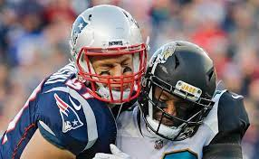
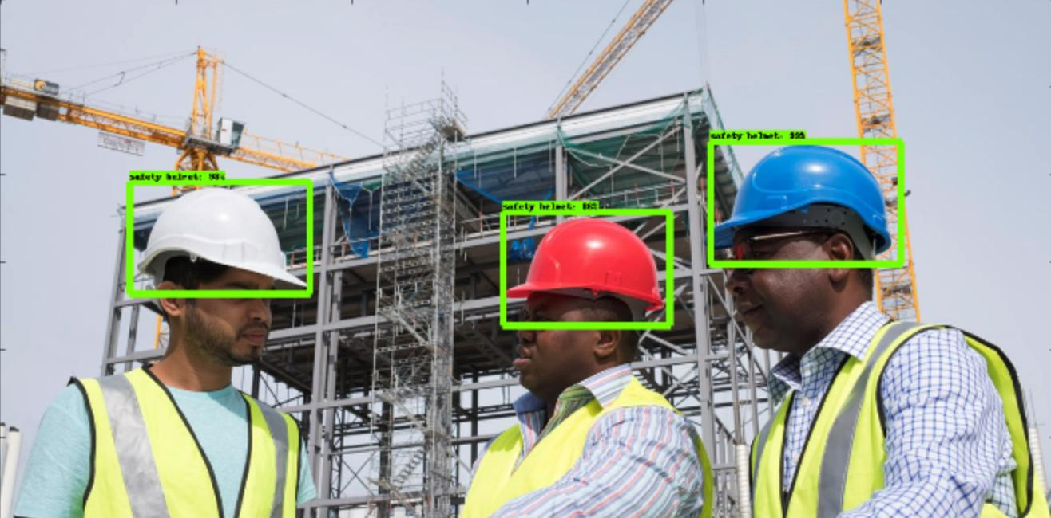
Where and How this project can be useful?
Sports Safety : Sports organizations can utilize helmet detection for ensuring that athletes wear helmets during practice sessions thereby reducing the risk of injuries.
Workplace Safety : Industries such as construction, manufacturing, and mining can use helmet detection to ensure that workers are wearing for safety.

Slide 4
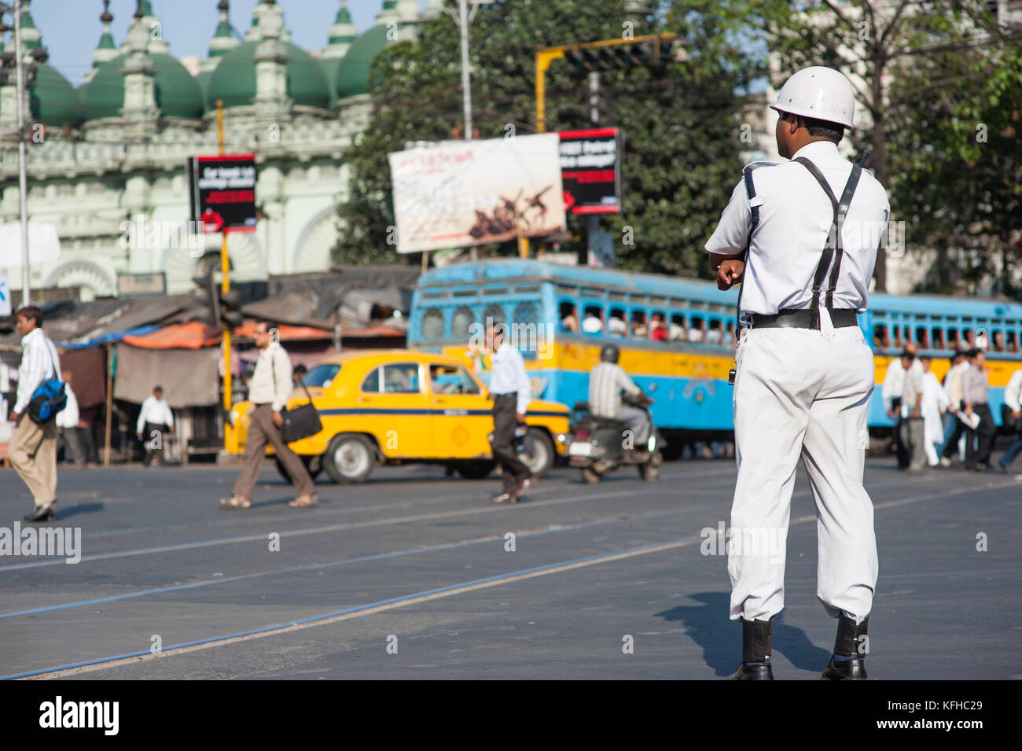
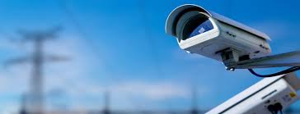
Traffic Enforcement: Traffic authorities can employ helmet detection to enforce helmet laws for motorcyclists, promoting road safety.
Security Surveillance: Helmet detection can be integrated into security surveillance systems to identify individuals wearing helmets in restricted area or during suspicious activities

Slide 5
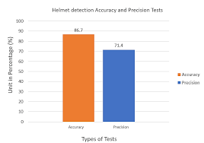
ADVANTAGES
Accuracy: Amazon Recognition utilizes advanced deep learning algorithms that have been trained on extensive datasets, resulting in high accuracy in detecting objects like helmets , beards.
Scalability: Being a cloud-based service, Amazon Rekognition can handle large-scale image processing tasks efficiently, making it suitable for projects requiring detection across a large number of images or video streams.
Ease of Integration: Amazon Recognition provides APIs that are easy to integrate into various applications and platforms.

Slide 6
Project at business scope and points of service
Businesses, particularly those in industries like construction, mining, or manufacturing where helmets are mandated for safety reasons, may identify a need for a helmet detection system to ensure compliance with safety regulations and minimize accidents.
we are done a project on this. We detect some pictures like if a persons wearing a helmet. how it helps to business side means if a person need any detecting pictures we will sell whatever they need.
For example they need beard detecting pictures or face etc…..
Its will help who are working in detecting object .
Also if we publish the detecting pictures in media the accuracy will increase . whatever pictures they need we will sell them live detecting pictures or videos.

Slide 7
How we plan to improve this project?
TensorFlow: A powerful deep learning framework developed by Google, widely used for building and training neural networks.
PyTorch: Developed by Facebook, PyTorch is known for its dynamic computational graph and ease of use in building deep learning models.
YOLO : YOLO is a popular real-time object detection system known for its speed and accuracy.

Slide 8
THANK YOU

